Slide 1


SHOKITE VEHICLE RENTAL
Object Oriented
Analysis Design
By
Prof. Thomas Shokite
BY,
Rishikesh Reddy
Hema Kothari
Mounika Donepudi

Slide 2

Promo Video

Slide 3
TABLE OF CONTENTS
OBJECTIVES
PRODUCT BACKLOG
FLOW CHART
SPRINT 2 ACCOMPLISTMENT
SCREENSHOT/ DEMO

Slide 4
Objective
To develop a web application for vehicle rental service with latest technology such as Voice Recognition.
Customers can find different vehicle services according to their requirements either for business or personal use.
We are here to give the best service to our customer and ensure they get their things to happen as they wanted.
To create a system that will reduce paper work and consume less time for Booking.

Slide 5
Product Backlog
NO: | STORY | PRIORITY
1 | As a User, I want to search vehicle based on passenger capacity so that I can select a vehicle from the list of search results | 5
2 | As a User, I want to search vehicle based on Price Range so that I can select a vehicle from the list of search results | 6
3 | As a User, I want to search vehicle based on Vehicle type so that I can select a vehicle from the list of search results | 7
4 | As a User, I want to search vehicle based on Transmission Mode so that I can select a vehicle from the list of search results | 8
5 | As a User (Member) I want to Register my information to create an account | 9
6 | As a User (Member) I want to login using my account details. | 10
7 | As a User I want to View all my bookings | 11
8 | As a User, I want to filter vehicles based on the price range say low to high or high to low | 13
9 | As a User, I want a billing interface that gives User access to pay using Cards, Cash, Direct Deposit, Android/Apple pay, cashier’s check and reward points | 16
10 | As a User I want to Enter Location by Voice Recognition to search vehicle on rent. | 22

Slide 6
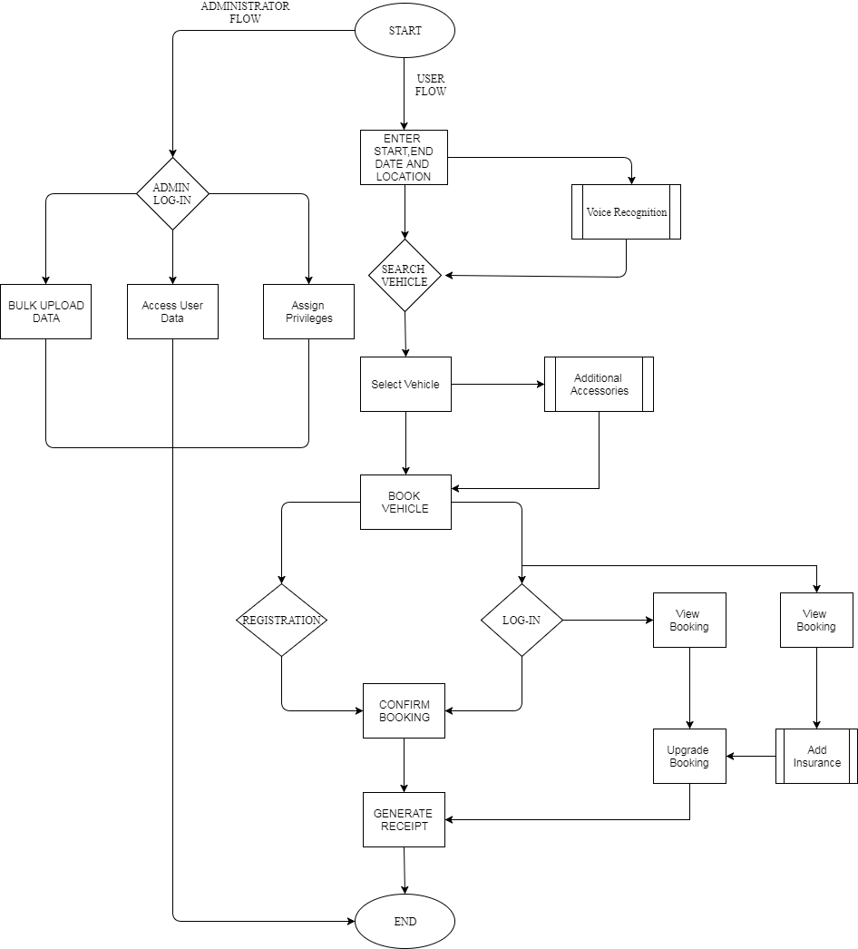
Flowchart

Slide 7
Sprint 2 Accomplishments
Voice Recognition for Location.
Filter vehicle using different criteria.
Vehicle Sorted by Price Range.
Continue as Guest Booking.
Booking vehicle with Registration and Login.
View details of Booked Vehicle.

Slide 8
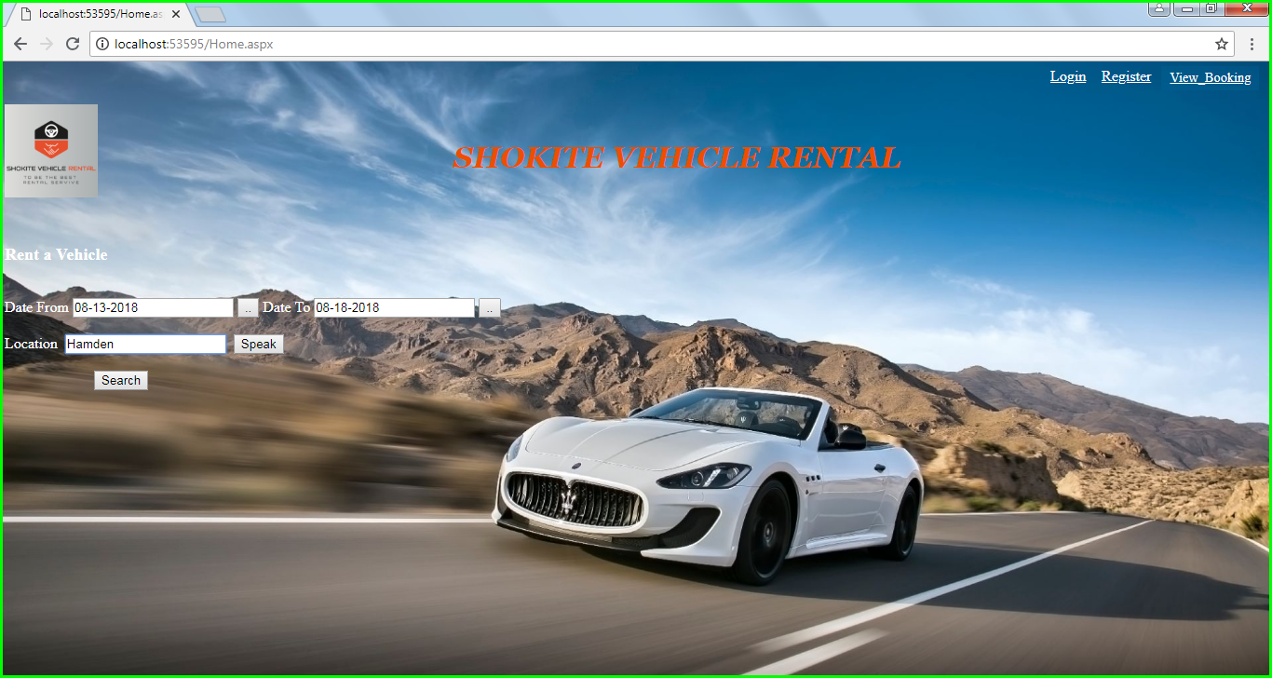
Home Screen

Slide 9
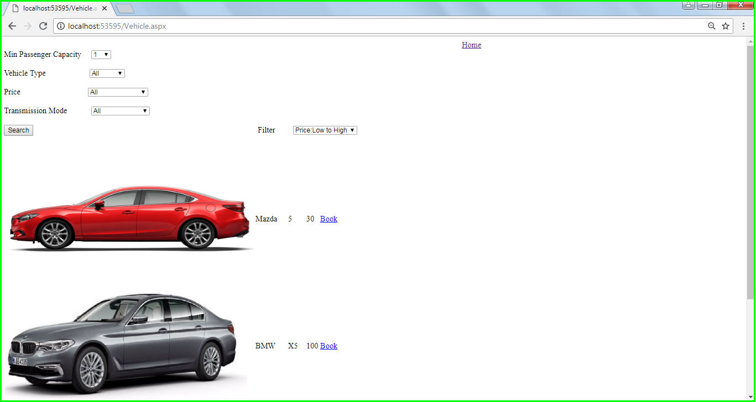
Vehicle List

Slide 10
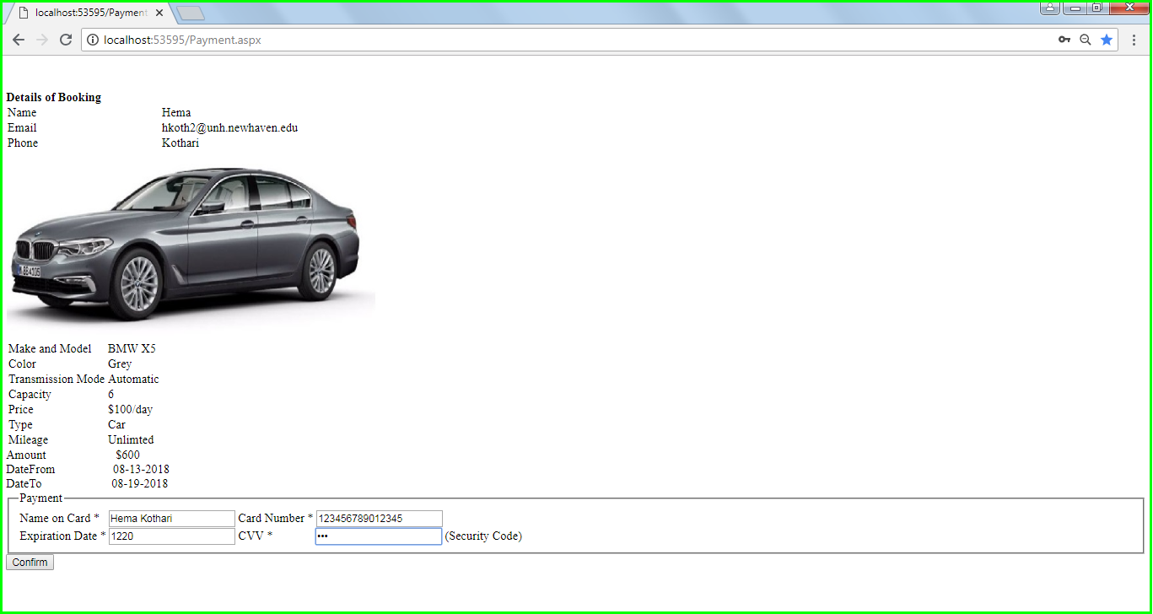
Review and Payment

Slide 11
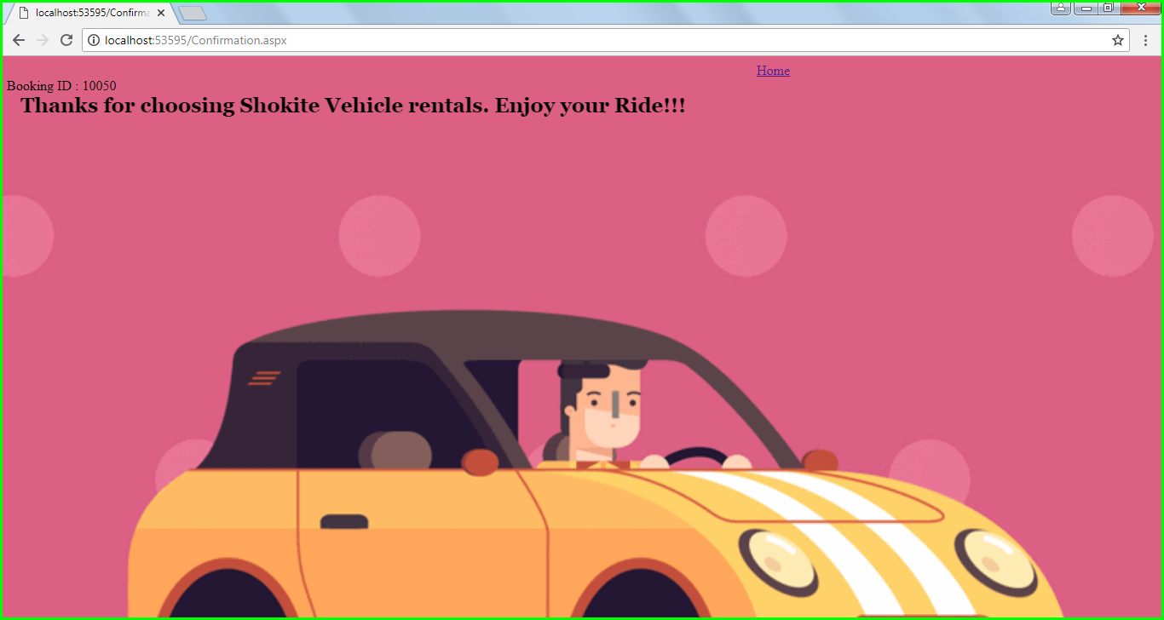
Booking Confirmation

Slide 12
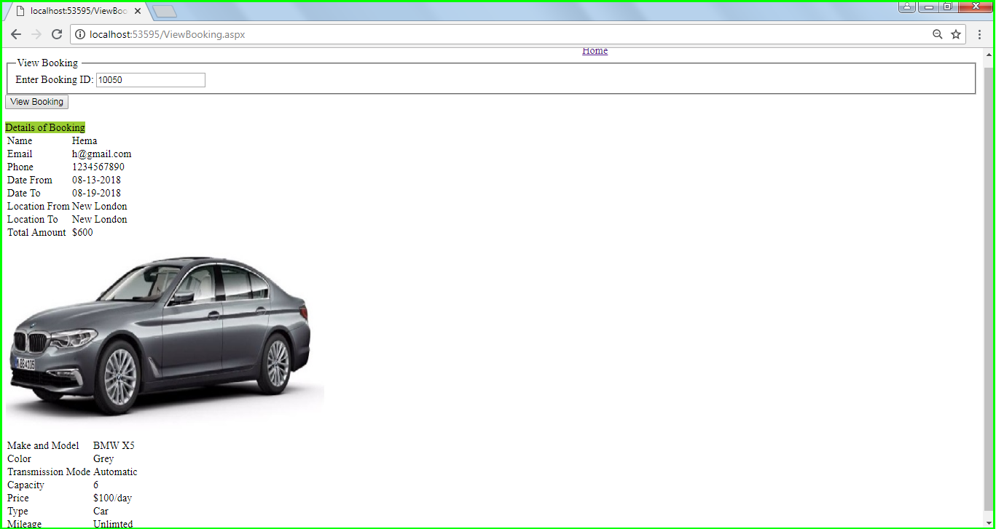
View Booking

Slide 13


Thank you
Any Questions??

